Slide 1
KS git configure and guide
Edward

Slide 2
Reference
KS BMC start guide
  https://data.bmc-ks.xyz/
Gerrit code review site
  https://gerrit.bmc-ks.xyz/

Slide 3
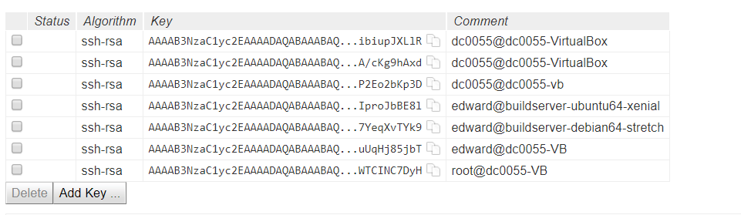
1. Setup Git Environment
Purpose: To clone/pull/fetch source code from KS git server
Refer to https://data.bmc-ks.xyz/
  Setup Git Environment
Upload SSH key
  https://gerrit.bmc-ks.xyz/#/settings/ssh-keys

Slide 4

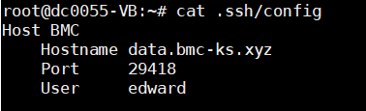
1. Setup Git Environment (cont.)
SSH key example
Git settings example
SSH config example (important!!!!!)

Slide 5
2. Setup OpenGPG
Purpose: To commit/push code to KS git serve
Refer to https://data.bmc-ks.xyz/
  Setup OpenGPG
Upload GPG key
  https://gerrit.bmc-ks.xyz/#/settings/gpg-keys

Slide 6

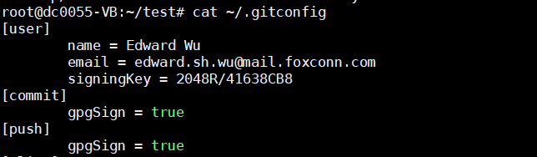
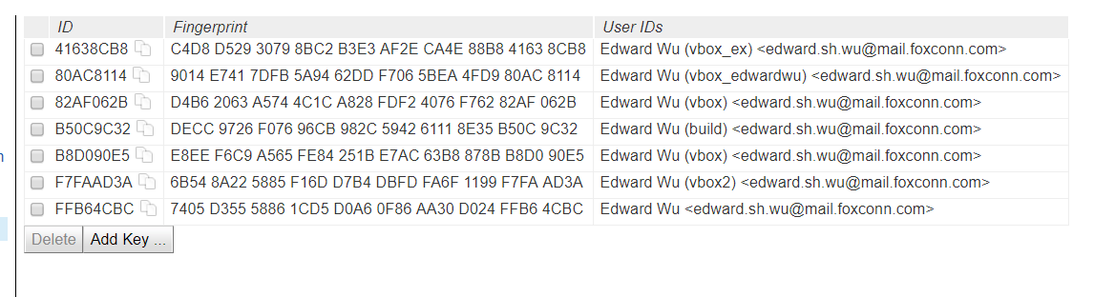
2. Setup OpenGPG (cont.)
GPG key example
Git config example
GPG key oploaded

Slide 7
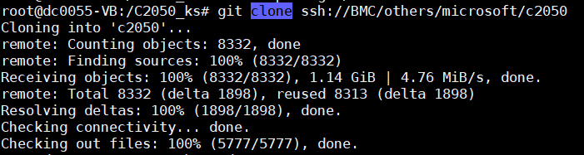
3. Clone C2050 from KS git server
git clone ssh://BMC/others/microsoft/c2050

Slide 8
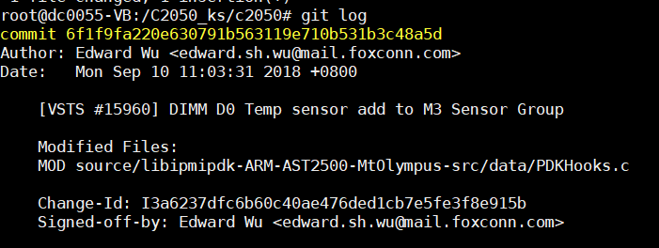
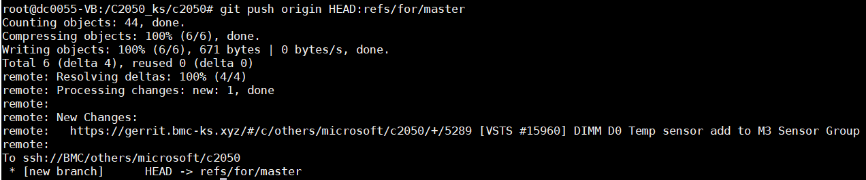
4. Push C2050 to KS gerrit server
git push origin HEAD:refs/for/master

Slide 9
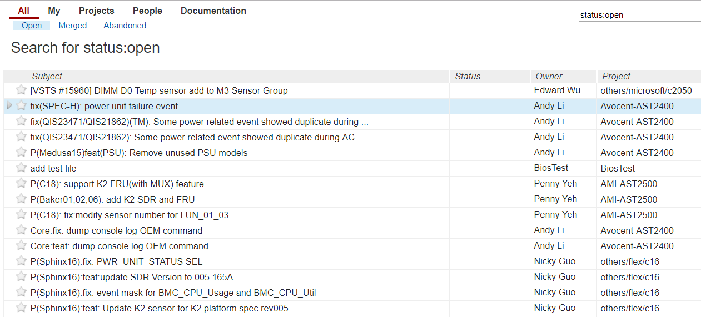
5. Check the commit on gerrit
https://gerrit.bmc-ks.xyz

Slide 10
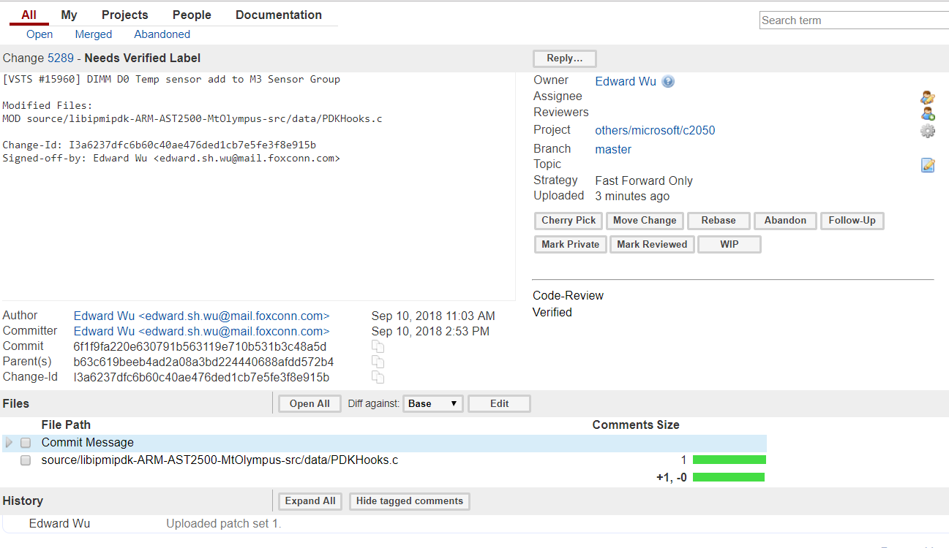
5. Check the commit on gerrit (cont.)
You can edit files & commit msg online if needed

Slide 11
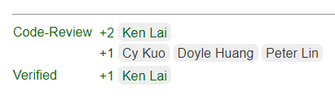
5. Check the commit on gerrit (cont.)
+2 = Review completed = Commit will push to git server

Slide 12
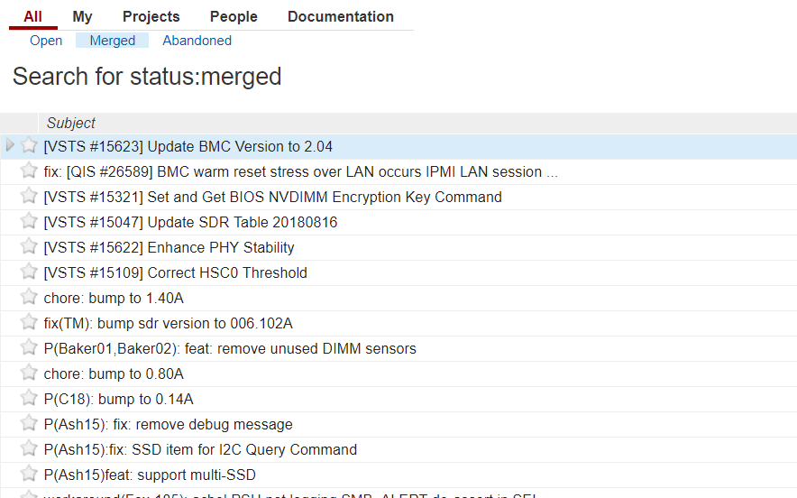
5. Check the commit on gerrit (cont.)
To check if commit already push to git server

Slide 13
6. Sync VTVS commit to KS
In the folder which clone from ssh://BMC/others/microsoft/c2050
[Add and switch to VTVS C2050 master]
1. git remote add msft https://azurecsi.visualstudio.com/C2050/_git/BMC
2. git fetch msft
3. git checkout msft/master
4. git log
5. Remember the “commit number” you need to sync to KS server
[Switch back to KS C2050 master]
1. git checkout origin/master
2. git cherry-pick [commit number]
3. Check if you pick all of the commit from VTVS you need
4. git push origin HEAD:refs/for/master
Sync VSTS commit to KS server complete.

